Slide 1

Department of Computer Science &Engineering Artificial Intelligence & Machine Learning
A.P. Shah Institute of Technology G.B.Road,Kasarvadavli, Thane(W), Mumbai-400615
UNIVERSITY OF MUMBAI
Academic Year 2023-2024

Slide 2
RESUME BUILDER
By
Yogesh vartak (22106119)
Dhruv Wesavkar (22106016)
vedant vethekar (22106090)
shravan thakur (22106086)

Slide 3
Introduction
This application helps build a resume for an individual.
The system is malleable for creating an appropriate resume according to qualification by reducing the need of thinking.
Usually individuals get confused while creating a resume especially fresher’s who are looking for new jobs. They are not much clear about what things and information must be included in a resume.
This application will provide an easy way of developing a resume that will look like a professional resume.

Slide 4
Objective
The main objectives of the Online resume builder is to manage the details of resume, job, Individual, Skills, Qualification.
I It manages all the information about resume, jobseeker, qualification, resume.
We will develop a web application that will auto-generate a nice and properly formatted resume from the information filled up in a form.

Slide 5
Features
Simplicity: Ensure ease of use for all users.
Customization: Allow users to tailor resumes to specific needs.
Efficiency: Streamline the resume creation process.
ATS Compatibility: Optimize resumes for applicant tracking systems.
Mobile Accessibility: Enable resume building on various devices.
Real-time Preview: Provide instant feedback on resume design.
Multi-format Export: Allow export in diverse file formats (e.g., PDF, HTML).
Professional Templates: Offer pre-designed templates for visually appealing resumes

Slide 6
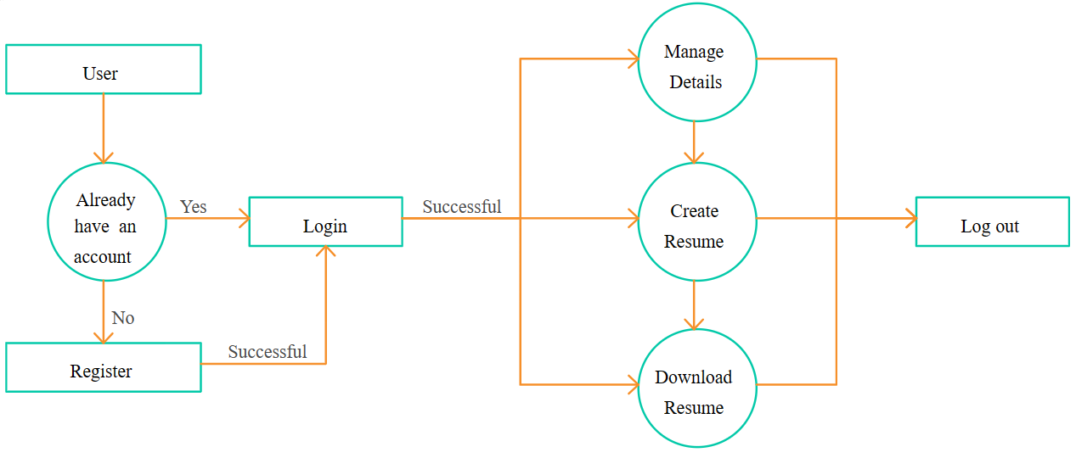
Block Diagram

Slide 7
Conclusion
The proposed application is very helpful and makes the resume formation easy so that a person can get his resume in a formal format without any issues just by using this resume builder application. It is mainly focused on format by simply choosing the desired template and giving some necessary details to the application and the resume builder app will process this raw information into the finished resume easily.

Slide 8
References
https://www.researchgate.net/publication/341779638_Resume_Builder_Application
https://www.linkedin.com/learning/
https://zety.com/blog

